Slide 1
Residual Analysis and Model Repair
Chapter 12
Built from current MLR slides 132-146

Slide 2
The Residual Vector
We can verify modeling assumptions by looking at properties of the residuals.
$e$has mean zero for each $x$ suggests $ε$ has mean zero.
$e$is homoskedastic suggests $ε$ has constant variance $σ^{2}$.
$e is approx.$ normally distributed suggests $ε\sim N(0,σ^{2})$.
If $e$doesn’t meet these conditions, we can try to update our predictors.

Slide 3
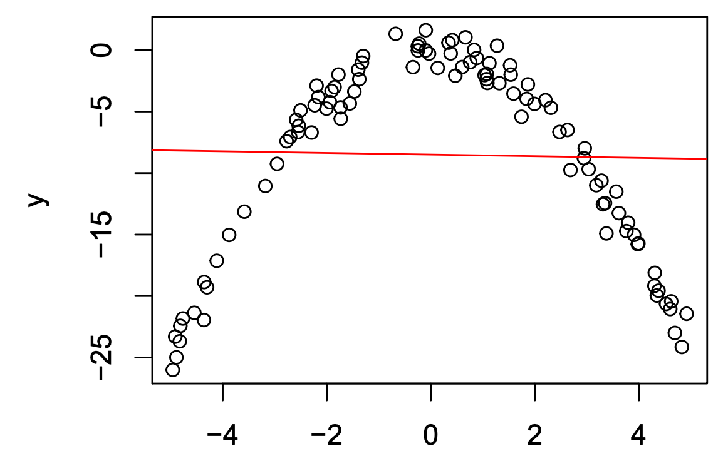
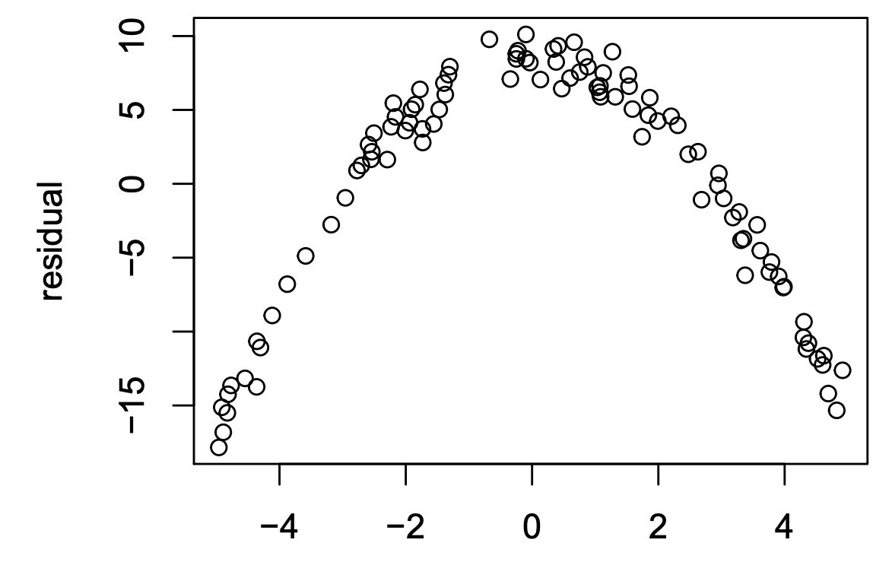
Example

Slide 4
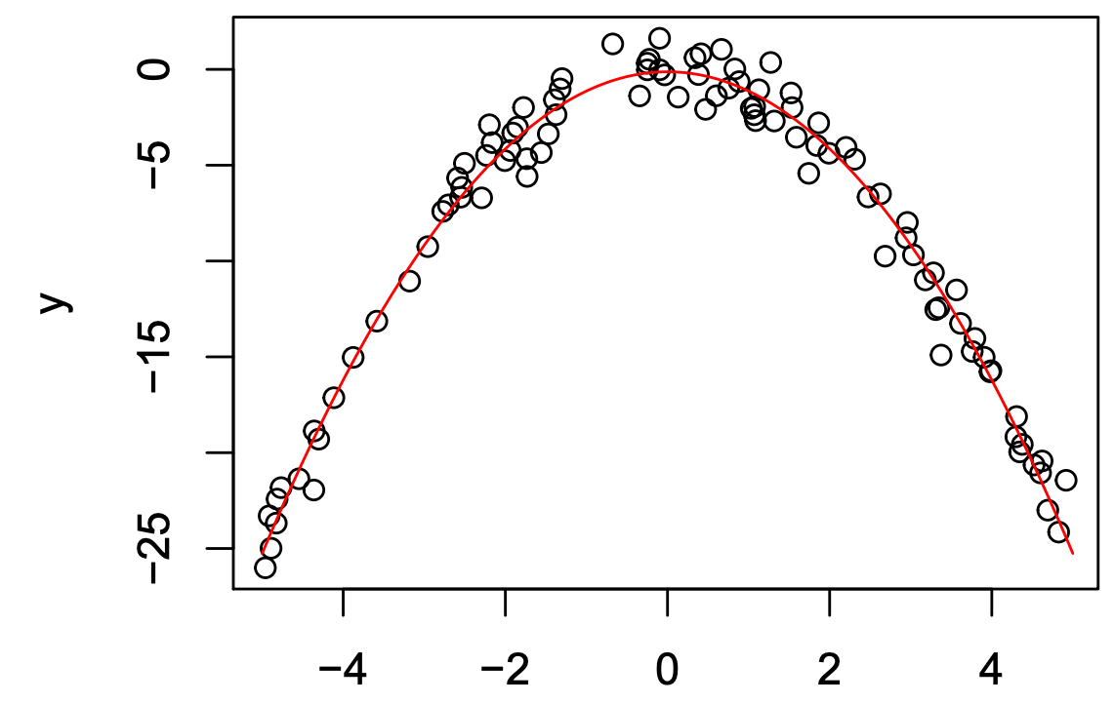
Example

Slide 5
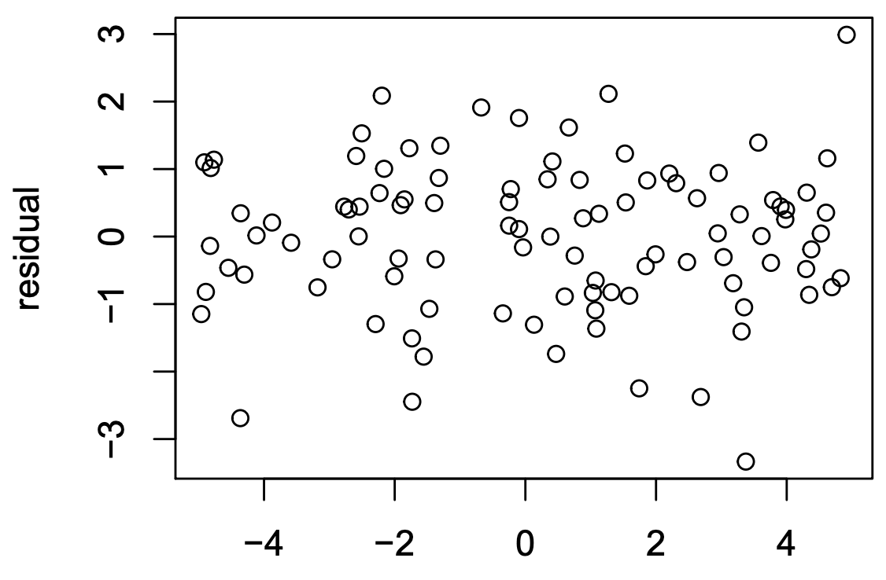
Example

Slide 6
Better Fitting Models
This opens up many more possibilities of modeling the relationship of our data with a linear model.
We can examine the residual behavior from our Truth+Error discussion to help us decide what a “better” model is.
Use this along with Test MSE to compare models.

Slide 7
Residual Analysis
The Idea:
Suppose our residuals are bad. What can we do about it?
Transform the predictors and/or the response.

Slide 8
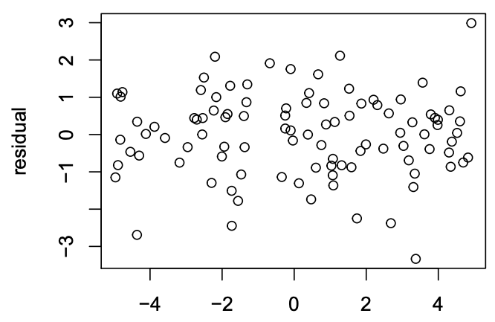
Examples

Slide 9
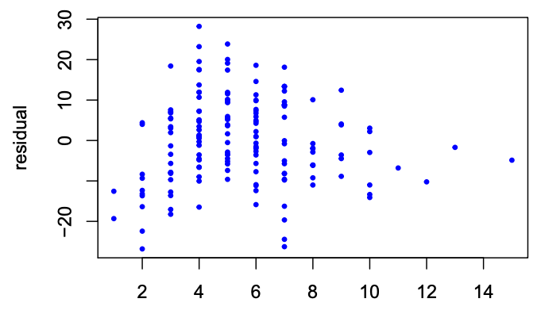
Examples

Slide 10
Residual Analysis
The Idea:
Suppose our residuals are bad. What can we do about it?
Add interactions of variables.
We will discuss this in a separate lecture.

Slide 11
Residual Analysis
The Idea:
Suppose our residuals are bad. What can we do about it?
Admit defeat.
There a few more niche tools to try out.
Step back and realize what this is telling us.

Slide 12
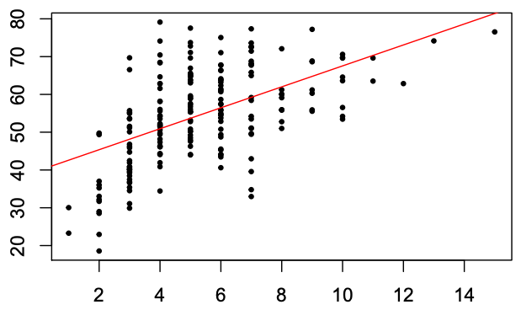
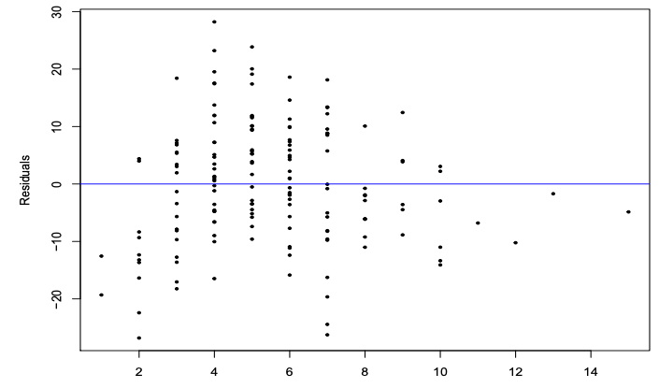
Example: A Linear Fit

Slide 13
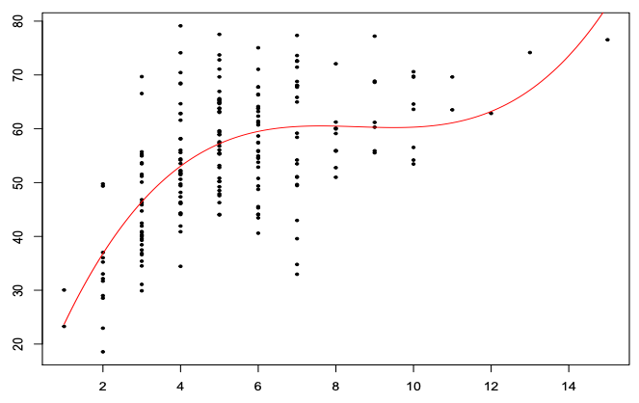
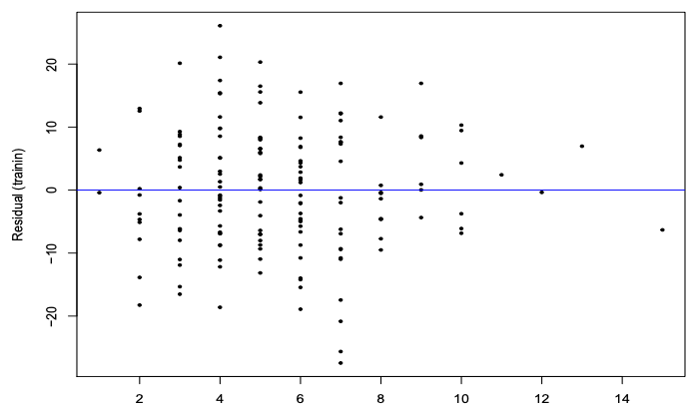
Example: A 3rd Deg Polynomial Transformation

Slide 14
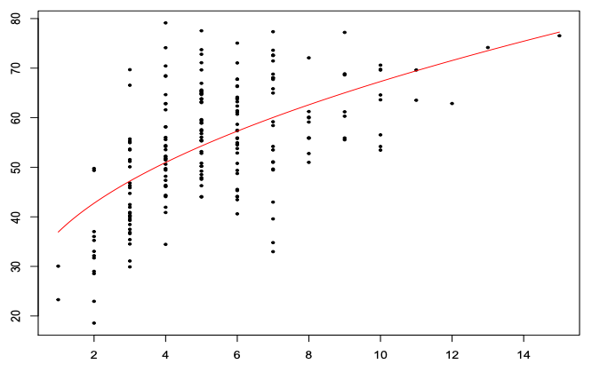
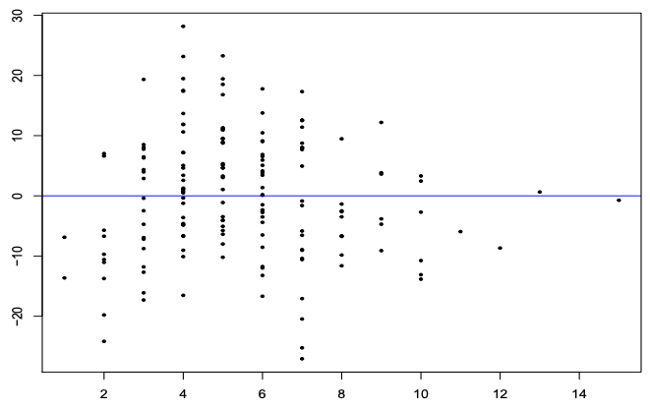
Example: A Square Root Transformation

Slide 15
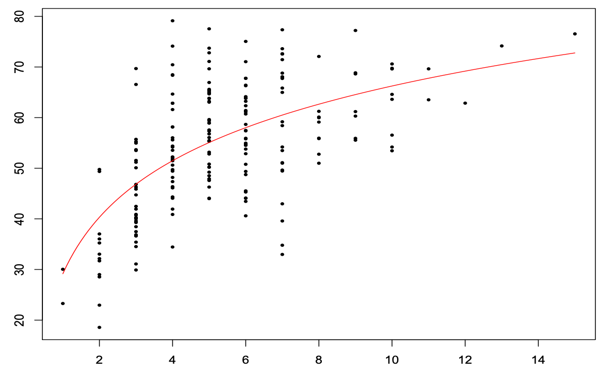
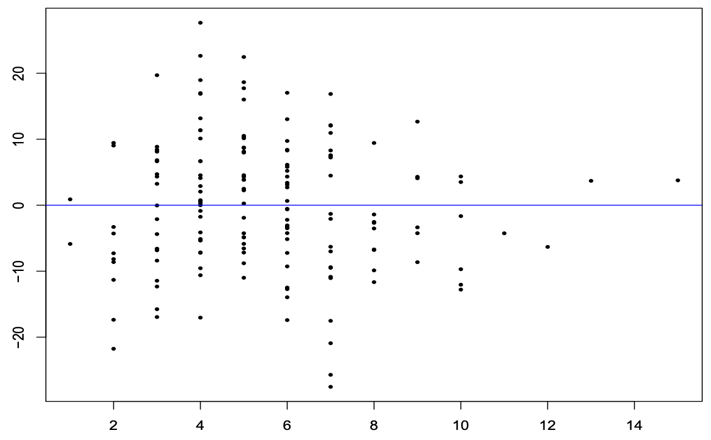
Example: A Logarithmic-Linear Transformation

Slide 16
Which One Wins?
There is a little bit of qualitative (read: subjective) analysis.
Use some of the intuition built during EDA.
We have other tools to help justify our analyses.
Be wary of taking a single hypothesis test in a vacuum.

